Slide 1
Part 8 ORM in Django
Version: 4.0.1
Written and design by: Babar ali

Slide 2
What is ORM?
One of the most powerful features of Django is its Object-Relational Mapper (ORM), which enables you to interact with your database, like you would with SQL. In fact, Django's ORM is just a Pythonical way to create SQL to query and manipulate your database and get results in a Pythonic fashion.
The ORM’s main goal is to transmit data between a relational database and application model. The ORM automates this transmission, such that the developer need not write any SQL.
This makes the whole development process fast and error-free.

Slide 3
The Problem Solved by ORM
ORMs have certain benefits over the traditional approach. The main advantage ORMs provide is rapid development. ORMs make project more portable. It is easier to change the database if we use ORMs.
In the past, web developers needed to have knowledge of databases too. A database has been an important component from the start. The programming languages used for web development use classes and object for data-interpretation. The class is used to a defined data structure in web-applications. Then the same database schema is created in the database. This task requires skill and knowledge of SQL.

Slide 4
Queryset in Django
We all use queries to retrieve data from the database. Querysets are Django’s way to retrieve data from the database. The Django ORM lets us use Querysets.
A Queryset is a list of objects of a model. We use Querysets to filter and arrange our data. These make our work as a Python developer easier.

Slide 5
What is Model in Django?
A model is a built-in feature that Django uses to create tables, their fields, and various constraints. In short, Django model is the SQL of Database one uses with Django.
SQL (Structured Query Language) is complex and involves a lot of different queries for creating, deleting, updating or any other stuff related to database.
Django Models simplify the tasks and organize tables into models. Generally, each model maps to a single database table.

Slide 6
Django Model
Each model is a Python class that subclasses django.db.models.Model.
Each attribute of the model represents a database field.
With all of this, Django gives you an automatically-generated database access API.
Example:
Name | Father Name | Roll No | Address
Babar Ali | Sammad Khan | 145986 | Shabqadar
Umair Khan | Haris Khan | 345765 | Halimzai
Imran Shah | Sadiq Shah | 123578 | Per Qilla

Slide 7
Create Your First Django Model
from django.db import models
class Person(models.Model):
first_name = models.CharField(max_length=30)
last_name = models.CharField(max_length=30)
first_name and last_name are fields of the model.
Each field is specified as a class attribute, and each attribute maps to a database column.

Slide 8
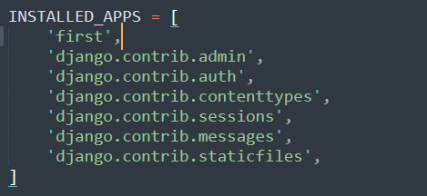
Add Your App in Django Project
If you are use your model first of all register your app in your Django model.
Go to settings.py then Go to INSTALLED_APPS section in section and add:

Slide 9
What is Migrate?
The migrate command looks at the INSTALLED_APPS setting and creates any necessary database tables according to the database settings in your mysite/settings.py file and the database migrations shipped with the app (we’ll cover those later). You’ll see a message for each migration it applies.
If you’re interested, run the command-line client for your database and type \dt (PostgreSQL), SHOW TABLES; (MariaDB, MySQL), .tables (SQLite), or SELECT TABLE_NAME FROM USER_TABLES; (Oracle) to display the tables Django created.

Slide 10
Migrate Your Model
Migrations for 'first':
first\migrations\0001_initial.py
- Create model Person
>>> python manage.py makemigrations
>>> python manage.py migrate

Slide 11
Your Model Coding
Go to your project. Then Go to the app Go to Migration and open it:
CREATE TABLE myapp_person (
"id" NOT NULL PRIMARY KEY,
"first_name" (30) NOT NULL,
"last_name" (30) NOT NULL
);
“ID” is the auto field for any Django model. Every model have a ID.
“first_name” is the CharField range is 30 characters and NOT NULL.

Slide 12
Playing With the API
Now, let’s hop into the interactive Python shell and play around with the free API Django gives you. To invoke the Python shell, use this command:
>>> python manage.py shell
This command will help you to enter the Django API Shell.

Slide 13
Django Database Queries
>>> from first.models import Person
Import the Person Model
>>> Person.objects.all()
Get all the Records
>>> haris = Person(first_name=“Haris”, last_name=“Khan”
Add record in Person table
>>> haris.save()
Save the record
>>> Person.objects.get(id=1)
Get a record where id is “1”

Slide 14
What is Django Admin.?
The Admin interface of a website is the control panel of your website/ project. It is used by the administrators of the website to add, delete and edit the content on the site, and also maintain other functionalities accordingly made by the developers.
The Django Admin is a fully featured interface and you won’t need to write an Admin interface for your project now. To begin with, it is always better to know the process of setting up Django Admin site as you will need it in future projects.

Slide 15
Setup Django Admin Site
Below are the steps to use the Django Admin Site and implement user models:
Step 1.
After starting the Django server, if we search in the URL bar:
localhost:8000/admin/
Step 2.
Open the PowerShell or terminal and break the server by Ctrl + C.
Then type in this command:
>>> python manage.py createsuperuser

Slide 16
Continue…
Step 3:
After executing this command, it will ask for your username, which is your choice again. Then it will ask you for the Email Id and Password. Complete the details.
There are some inbuilt security features here like if your password is totally numeric it will display a message to create a complex password and many such security loopholes have been covered up for users.

Slide 17
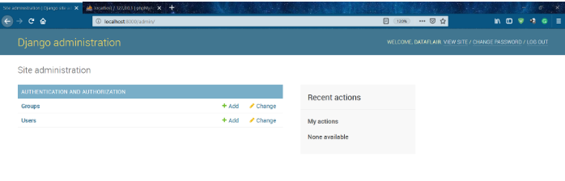
Continue…
Step 4.
Now login in admin using the credentials you just created.

Slide 18
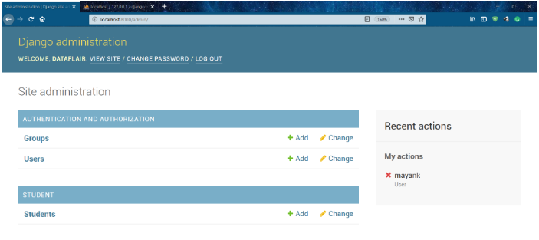
Continue…
Step 5.
Now click on the users field and you should see something like this.

Slide 19
Continue…
Step 6:
Now, you can check whether the user you created got saved in it. Although you didn’t do anything with the database.
Notice, that there are many tables which we didn’t create but are inside our database. They are all django.contrib package’s imported models tables. django.contrib is a package for Django which is comparable to the relation of standard library with Python. Almost all the functionality we need is already on the django.contrib package.

Slide 20
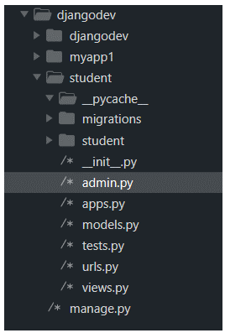
Continue…
Step 9:
Now open the file admin.py of your app. The directory structure should be like this.
Step 10:
Open the admin.py file and type in these two lines for register model
from .models import Student
admin.site.register(Student)

Slide 21
What is Super User.?
It is basically the credentials of the admin for your website, which can do any data manipulation and content manipulation related to your website.
Also, note that you should never share the superuser credentials with anyone, as it is the main controller of your website. When the website goes live, it is vital information for maintaining and controlling your website.
After successfully creating the superuser we are now going to log in to that admin page to start your Django server again.

Slide 22
Create Super User
>>> python manage.py createsuperuser
Enter “username” and “Email”.
Enter “password” and write “Y” for creating a super user.
Your Super User Created Successfully

Slide 23
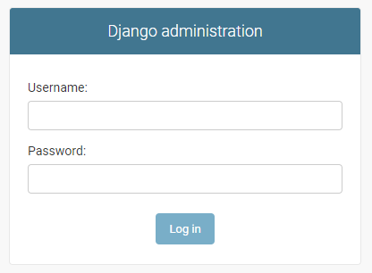
Admin Login (Super User)
The following image show that how the super user login to Django Dashboard.
Enter Username and Password then click to login.

Slide 24
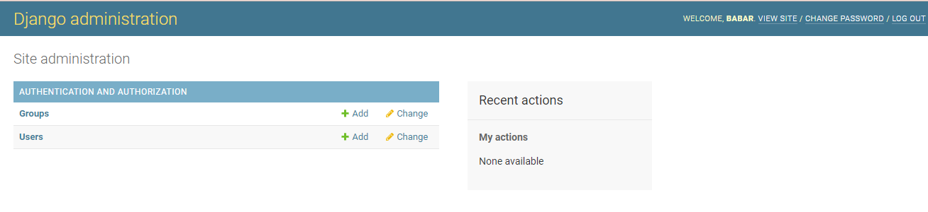
Django Admin Dashboard image

Slide 25
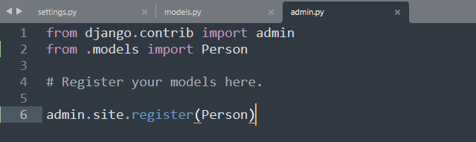
Register Your Model
You can see the above image of the admin dashboard. But your model is not showing if you want to show your model in admin site:
Then Go to the “admin.py” file and write the following code:

Slide 26
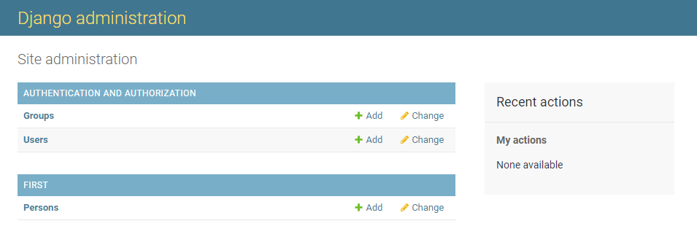
Here’s Your Model

Slide 27
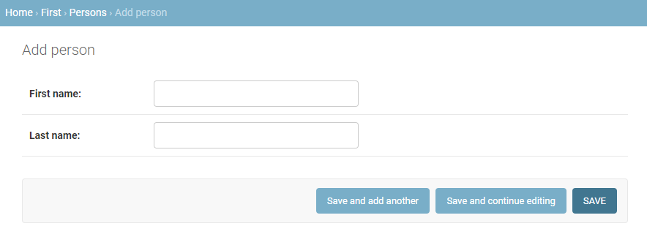
Add Person to Person Model

Slide 28
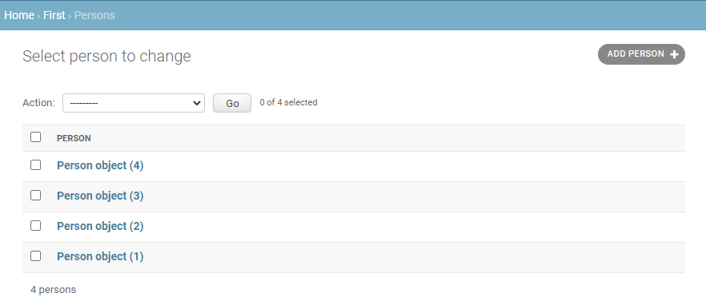
List of All Added Persons

Slide 29
Field Option
CharField (and its subclasses) require a max_length argument which specifies the size of the VARCHAR database field used to store the data.
Null : If True, Django will store empty values as NULL in the database. Default is False.
Blank : If True, the field is allowed to be blank. Default is False.
If a field has blank=True, form validation will allow entry of an empty value.
If a field has blank=False, the field will be required.

Slide 30
Choices
A sequence consisting itself of iterables of exactly two items (e.g. [(A, B), (A, B) ...]) to use as choices for this field. If choices are given, they’re enforced by model validation and the default form widget will be a select box with these choices instead of the standard text field.
YEAR_IN_SCHOOL_CHOICES = [
('FR', 'Freshman’),
('SO', 'Sophomore’),
('JR', 'Junior’),
('SR', 'Senior’),
('GR', 'Graduate’),
]
year_in_school = models.CharField( max_length=2, choices=YEAR_IN_SCHOOL_CHOICES, default=FRESHMAN)

Slide 31
Enumeration Types
In addition, Django provides enumeration types that you can subclass to define choices in a concise way:
class Student(models.Model):
class YearInSchool(models.TextChoices):
FRESHMAN = 'FR', _('Freshman’)
SOPHOMORE = 'SO', _('Sophomore’)
JUNIOR = 'JR', _('Junior’)
SENIOR = 'SR', _('Senior’)
GRADUATE = 'GR', _('Graduate')
year_in_school = models.CharField( max_length=2, choices=YearInSchool.choices, default=YearInSchool.FRESHMAN )

Slide 32
Field Options
Primary Key
If True, this field is the primary key for the model.
If you don’t specify primary_key=True for any field in your model, Django will automatically add a field to hold the primary key, so you don’t need to set primary_key=True on any of your fields unless you want to override the default primary-key behavior.
person_id = models.IntegerField(primary_key=True)

Slide 33
Field Options
unique
If True, this field must be unique throughout the table.
This is enforced at the database level and by model validation. If you try to save a model with a duplicate value in a unique field, a django.db.IntegrityError will be raised by the model’s save() method.
This option is valid on all field types except ManyToManyField and OneToOneField.
sites = models.ManyToManyField(Site, unique=True)

Slide 34
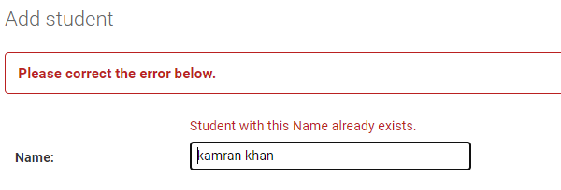
Field Option Unique Example
unique
If True, this field must be unique throughout the table.
Example
class Student(models.Model):
name = models.CharField(max_length=30, unique=True)

Slide 35
Field Options
Verbose field names
Each field type, except for ForeignKey, ManyToManyField and OneToOneField, takes an optional first positional argument – a verbose name. If the verbose name isn’t given, Django will automatically create it using the field’s attribute name, converting underscores to spaces.
sites = models.ManyToManyField(Site, verbose_name="list of sites")

Slide 36
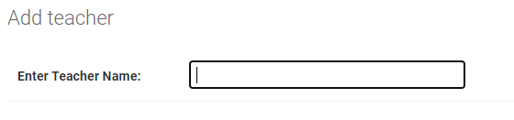
Verbose Field Option Example
Example
class Teacher(models.Model):
id = models.AutoField(primary_key=True)
name = models.CharField("Enter Teacher Name", max_length=30)

Slide 37
Thanks for Reading

